Slide 1
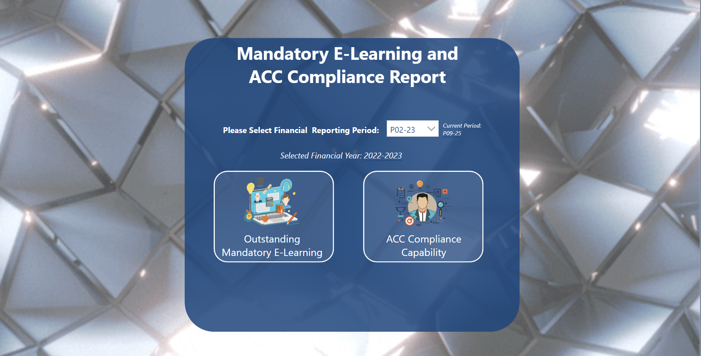
Detailed information has been emitted from this report.
Data has been manipulated to protect client information.

Slide 2
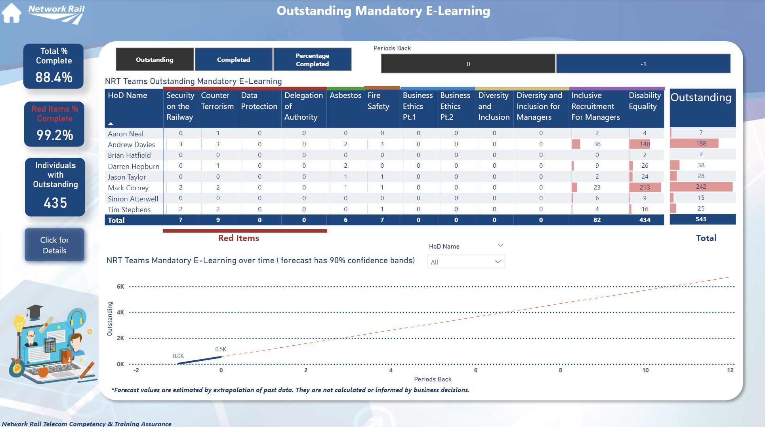

Slide 3
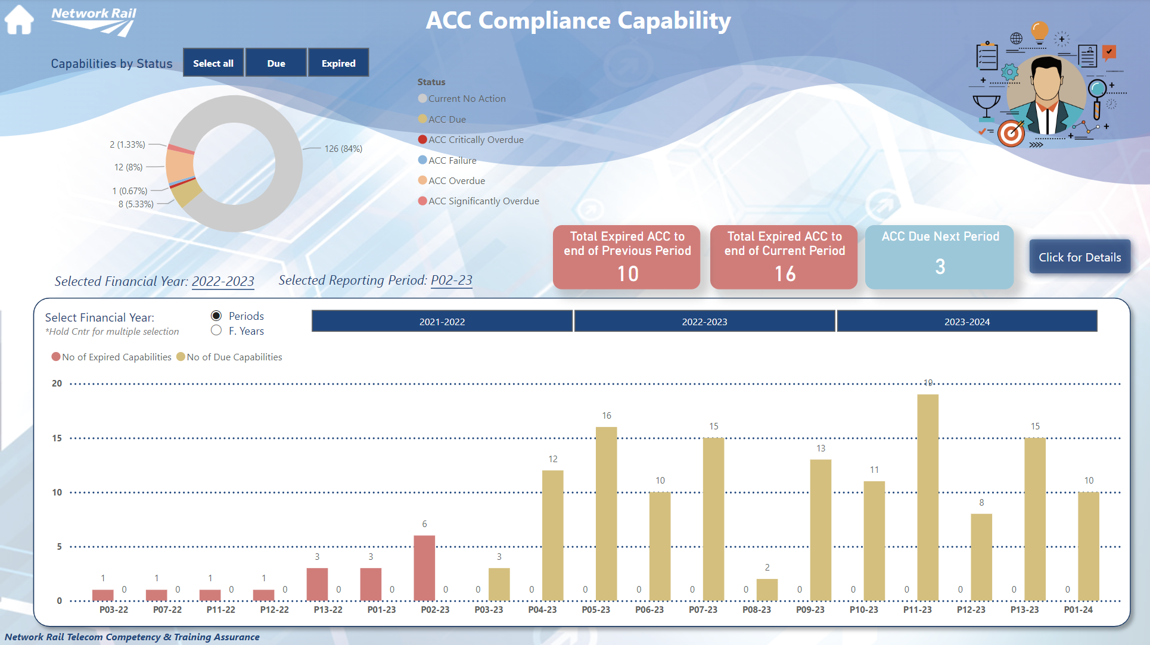

Slide 4
End

